Slide 1
Chapter 6
After-tax Economic Analysis

Slide 2
LEARNING OBJECTIVES
Determining cash flows before taxes(CFBT) and after taxes (CFAT)
Effects of depreciation on taxes
Determining the Rate of Return
Understanding value-added tax (VAT)

Slide 3
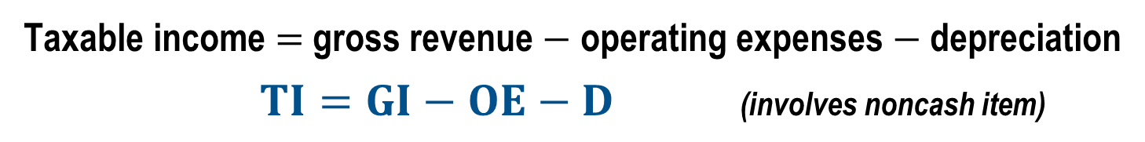
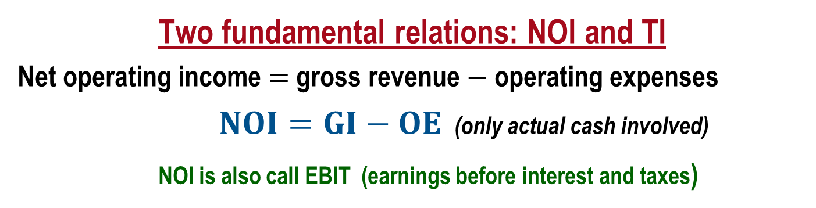
Income Tax Terms and Relations (Corporations)
Income taxes are real cash flow payments to governments levied against income and profits. The (noncash) allowance of asset depreciation is used in income tax computations.
Two fundamental relations: NOI and TI
Net operating income $=$ gross revenue $−$ operating expenses
$NOI=GI−OE$ (only actual cash involved)
NOI is also call EBIT (earnings before interest and taxes)
Taxable income $=$ gross revenue $−$ operating expenses $−$ depreciation
$TI=GI−OE−D$ (involves noncash item)
Note: All terms and relations are calculated for each year t, but the subscript is often omitted for simplicity

Slide 4
After Tax Cash Flow
Once firms are able to calculate their taxes, then the taxes are incorporated into engineering economic analysis evaluations to determine the after-tax cash flow (ATCF).
After-tax cash flows are used when calculating the after-tax rate of return, net present worth, future worth, and equivalent uniform annual worth.
The calculations for solving for these values use the same equations introduced in the previous chapters, but taxes are subtracted from the revenue before any of the formulas are applied to calculate these values

Slide 5
After Tax Cash Flow
Up until this chapter, all of the cash flow problems have been before-tax cash flows (BTCFs).
At this point, all of the cash flows become ATCFs since in the United States ATCFs are the accurate method for determining engineering economic values.

Slide 6
After Tax Cash Flow
The principal elements of ATCFs are the following
Before-tax cash flow
Depreciation
Taxable income (Before-tax cash flow − Depreciation)
Income taxes (Taxable income × tax rate)
After-tax cash flow (Before-tax cash flow − Income taxes)
These elements are usually arranged to form an after-tax cash flow table

Slide 7
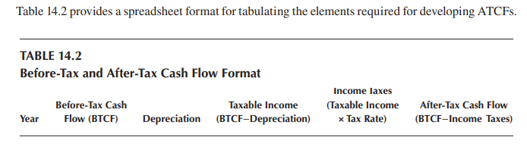
After Tax Cash Flow

Slide 8
After Tax Cash Flow
Example
The owner of a chemical processing firm pays $300,000.00 for a new piece of machinery. The firm is able to earn $280,000.00 from the machinery in years one and two. The machinery will have a salvage value of $75,000.00 at year five. Calculate the after-tax rate of return for years one and two using straight line depreciation and a corporate tax rate of 38%.
Figure 14.1 is the before tax cash flow diagram for the chemical processing machinery

Slide 9
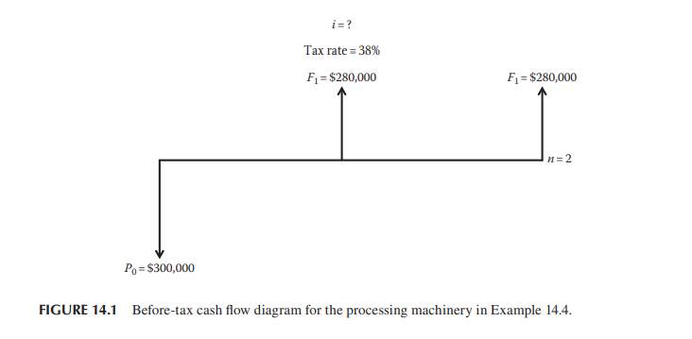
After Tax Cash Flow

Slide 10
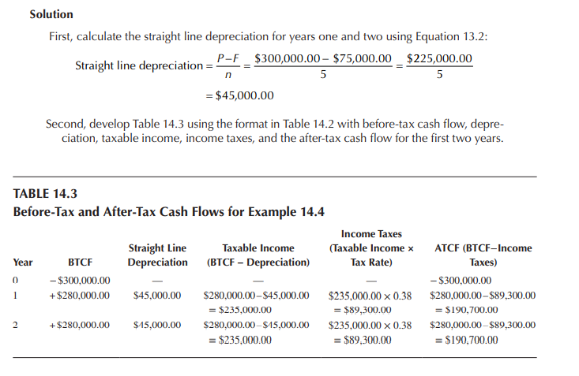
After Tax Cash Flow

Slide 11
After Tax Cash Flow

Slide 12
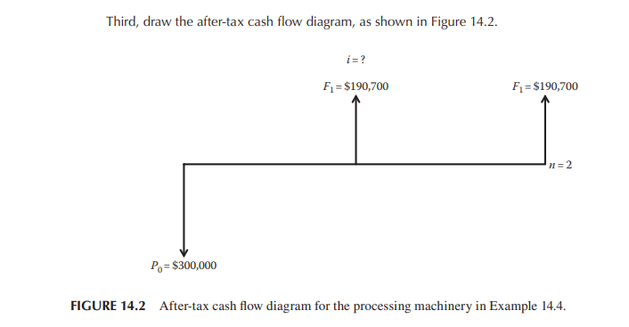
After Tax Cash Flow

Slide 13
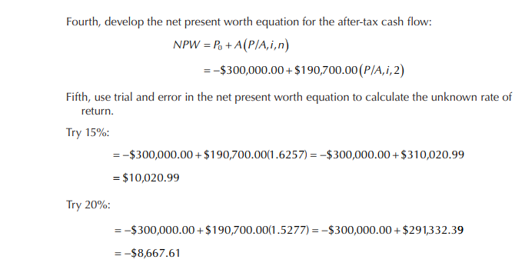
After Tax Cash Flow

Slide 14
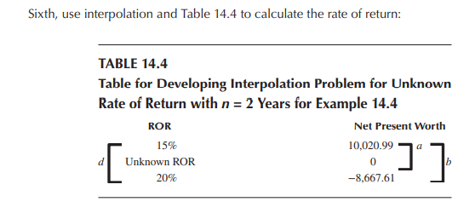
After Tax Cash Flow

Slide 15
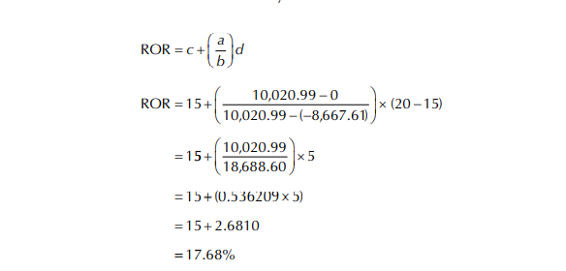
After Tax Cash Flow

Slide 16
After Tax Cash Flow
Example
A medium-sized profitable corporation may buy a $15,000 used pickup truck for use by the shipping and receiving department. During the truck’s 5-year useful life, it is estimated the firm will save $4000 per year after all the costs of owning and operating the truck have been paid. Truck salvage value is estimated at $4500.
What is the before-tax rate of return?
What is the after-tax rate of return on this capital expenditure? Assume straight-line depreciation.

Slide 17
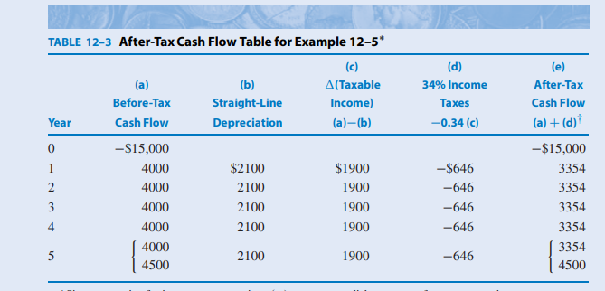
After Tax Cash Flow
IRRbt = 16.7% ; IRRat = 11.2%

Slide 18
After Tax Cash Flow
Taxable income is the before-tax cash flow minus depreciation.
For this medium-sized profitable corporation, let’s assume an incremental federal income tax rate of 34%.
Therefore income taxes are 34% of taxable income.
Finally, the after-tax cash flow equals the before-tax cash flow minus income taxes.

Slide 19
Value-Added Tax (VAT)
VAT is an indirect tax placed on goods and services, not on people and corporations like an income tax. The VAT is charged sequentially throughout the process of manufacturing a good or providing a service. The VAT is also called Goods and Service Tax (GST).
VAT CHARACTERISTICS
A percent, e.g., 10%, of current value, of unfinished goods or service (G/S) is charged to the purchaser and sent to taxing entity by manufacturer or provider
VAT charged to buyer at purchase time whether buyer is an end user or intermediate business
As next transfer occurs, VAT previously paid on unfinished G/S is subtracted from VAT currently due
SALES TAX CHARACTERISTICS
Charged only once at final product sale to the end user or consumer
Selling merchant sends tax to taxing entity
Businesses do not pay sales tax on raw materials or unfinished goods or service
Businesses do pay sales tax on items for which they are the end user

Slide 20
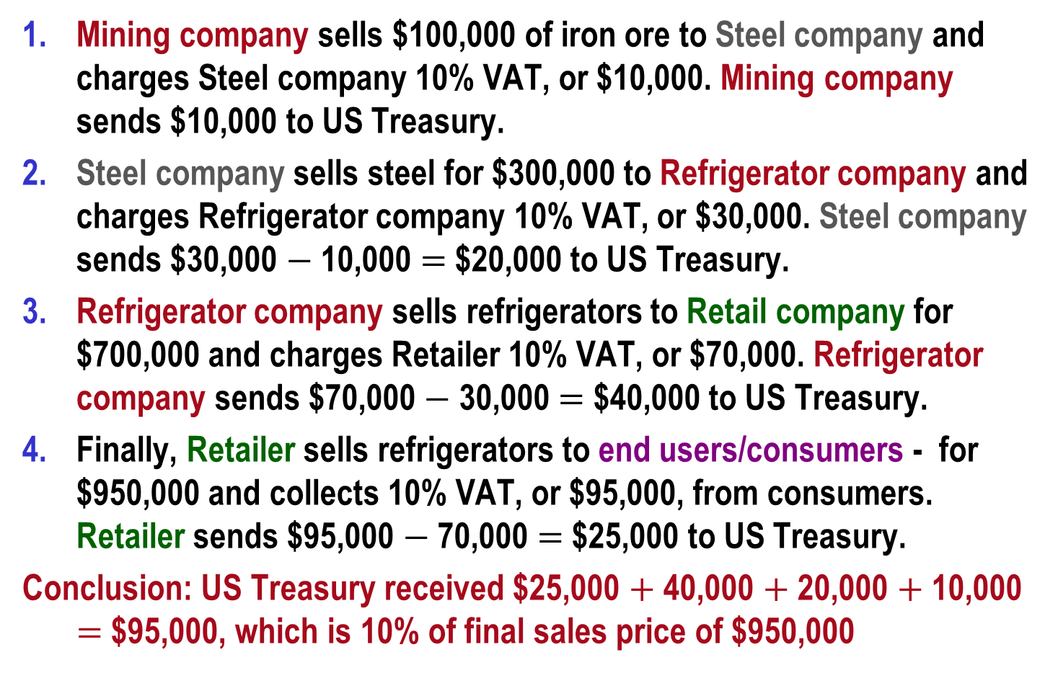
Example: How a 10% VAT Could Work in the US
Mining company sells $100,000 of iron ore to Steel company and charges Steel company 10% VAT, or $10,000. Mining company sends $10,000 to US Treasury.
Steel company sells steel for $300,000 to Refrigerator company and charges Refrigerator company 10% VAT, or $30,000. Steel company sends $30,000 $−$ 10,000 $=$ $20,000 to US Treasury.
Refrigerator company sells refrigerators to Retail company for $700,000 and charges Retailer 10% VAT, or $70,000. Refrigerator company sends $70,000 $−$ 30,000 $=$ $40,000 to US Treasury.
Finally, Retailer sells refrigerators to end users/consumers - for $950,000 and collects 10% VAT, or $95,000, from consumers. Retailer sends $95,000 $−$ 70,000 $=$ $25,000 to US Treasury.
Conclusion: US Treasury received $25,000 $+$ 40,000 $+$ 20,000 $+$ 10,000 $=$ $95,000, which is 10% of final sales price of $950,000

Slide 21
Summary of Important Points
A medium-sized profitable corporation may buy a $15,000 used pickup truck for use by the shipping and receiving department. During the truck’s 5-year useful life, it is estimated the firm will save $4000 per year after all the costs of owning and operating the truck have been paid. Truck salvage value is estimated at $4500. a. What is the before-tax ROR? b. What is the after-tax ROR? Assume straight-line depreciation, 34% tax rate.

